Slide 1
CLOUD ARS We specialize in Cloud Automation (SaaS) Powered by Team (ARS) : Anjali - Raja - Sneha

Slide 2
INTRODUCTION
2
OVERVIEW:
At Cloud ARS, we provide our services (SaaS) for a free trial period of 60 days to determine our potential customers.
During this trial period we analyze the behavioral pattern of the users, based on certain parameters such as their :
On Board Age
Average Daily Time Spent
Number of Virtual Machines Deployed
Top Hit URL's Categories
We performed Exploratory Data Analysis (EDA) to gauge some important features for us to train a machine learning model.
We created a Machine Learning Model using Logistic Regression to predict the Potential Customers out of the users in our Trial phase.
Data Source: Merged modified features from previously submitted project Team Data Guru.

Slide 3
WHAT ARE WE TRYING TO ACHIEVE?
Can this be a Paid Potential Customer ?
Optimum Utilization of the Company’s Resources & Channel Partners.
Guiding the strategic team to focus on pre-predicted potential customers, resulting higher Return on Investment.
Establish an independent platform / model which is production ready to test / input with unknown parameters influencing the machine learning model which will predict if the customer can be potential paid customer or not.

Slide 4
EXPLORATORY DATA ANALYSIS (EDA)

Slide 5
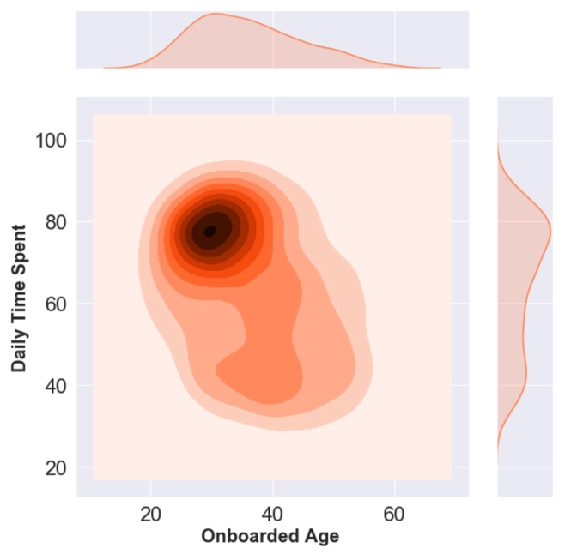
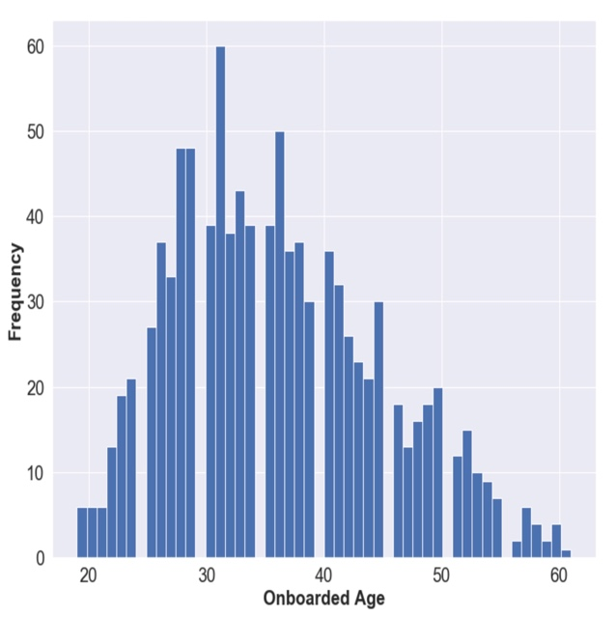
Onboard Age vs Daily Time Spent
5
On board age of a user is defined as: how many days has the potential customer used the service (trail version) provided by our company.
Analysis: On an average between 20 and 40 days of using our service, the user spent approx. 80 mins on exploring the service.
Maximum time spend on our service is after 30 days of getting acquainted with our service. Most user activity / daily time spent on our service is between 60 to 90 mins.
As the on-board age goes beyond 40 days, towards the end of our trail period we see less time daily time spend / reduced web traffic / activity on our website, as expected since the customer explored our product and is now ready to come on board.
Onboard Age vs Frequency
The maximum frequency peaks between 30 to 40 days of using the service.
Towards the end of the 60 days trial, we see a gradual decrease in the frequency.
We see a higher density of frequency in the first half of trail period within the first 30 days of the trial session

Slide 6
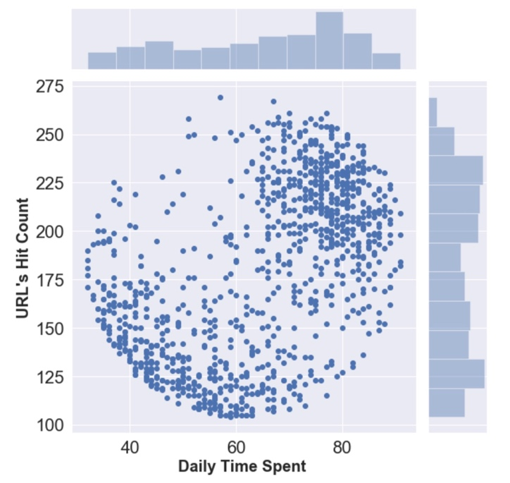
Daily Time Spent vs URL Hit Count
Clear depiction that the data set is divided in two clusters.
The first cluster derived on the basis of: Lower daily time spent (between 35 to 65 mins) with an average between 110 to 150 URL hit counts.
The second cluster derived on the basis of: Higher daily time send (between 75 to 95 mins) with a higher URL hit count, ranging from 200 to 250 URL hits.
Outliers to be considered while analysis:
A few dispersed data points can be seen within 40 to 60 mins of the trial service with a substantial number of URL hits going up to 275 hit counts.
Another outlier to be considered is, some customers used the service for approximately 80 mins and had a comparatively lower URL hit count.
Categories vs URL Hit Count
This analysis depicts the most profitable top 20 URL categories of our service.
Helps us to gain an insight of what service our customer’s are more inclined towards.
URL hit counts and its frequency helps us to determine which sector or potential customer need to be addressed.

Slide 7
ML MODEL INSIGHTS (Model used: Binary Logistic Regression for predictive analysis for paid potential customers)

Slide 8
Basic Premise of Validation using Training/Testing Data
8
Full Data Set (Historic)
N=1000
Daily Time Spent | Onboard Age | Number of VM Counts | Number of URL’s Hits
47.64 | 49 | 45633 | 122.02
63.45 | 23 | 52182 | 140.64
54.7 | 36 | 31088 | 118.39
Training Data Set
Test Data Set
Daily Time Spent | Onboard Age | Number of VM Counts | Number of URL’s Hits
47.64 | 49 | 45633 | 122.02
63.45 | 23 | 52182 | 140.64
…. | …. | …. | ….
Daily Time Spent | Onboard Age | Number of VM Counts | Number of URL’s Hits
47.64 | 49 | 45633 | 122.02
63.45 | 23 | 52182 | 140.64
… | … | … | …
N=700
N=300
DATA SPLIT RATIO - 70%:30%

Slide 9
Basic Premise of Validation - Training
Training Data Set
Daily Time Spent | Onboard Age | Number of VM Counts | Number of URL’s Hits
47.64 | 49 | 45633 | 122.02
63.45 | 23 | 52182 | 140.64
…. | …. | …. | ….
Fit (Train) the Model
Model
We use the training data to fit the model to the data.
This is the training step where we build a model that can predict our output (Potential Paid customer) for a given set of features (Daily Time Spent, Onboard Age, Number of VM Counts, Number of URL’s Hits).
Once the model is trained, we can use the model to make predictions.

Slide 10
Basic Premise of Validation
10
Model
Make Predictions!
Daily Time Spent | Onboard Age | Number of VM Counts | Number of URL’s Hits | Potential Customer (Predicted) | Potential Customer (Actual)
47.64 | 49 | 45633 | 122.02 | 1 | 1
63.45 | 23 | 52182 | 140.64 | 0 | 0
…. | …. | …. | …. | …. | ….
We use the Test data to make new potential paid customer predictions.
We can then compare the potential paid customer value (0 or 1) of our Prediction vs. the Actual value.
Based roughly on how often we are “correct”, we get a score for the model as a whole.
If the model scores well, then we can trust it for future use. We train the model on the Training data and Score the model based on data that it has never seen before (Test Data).

Slide 11
CLASSIFICATION REPORT FOR MODEL ARS
Class | F1 Score | Precision | Recall | Support
0 | 0.90 | 0.84 | 0.97 | 146.0
1 | 0.89 | 0.96 | 0.82 | 154.0
Average/Total | 0.89 | 0.90 | 0.89 | 300.0
R2 | MSE
0.8966 | 0.1033

Slide 12
Common Scoring Metrics
R² (R-Squared): This is the baseline metric that many ML tools report on score.
Higher R² values signify that the model is “highly predictive”. An R² value of >0.90 means that our model roughly accounts
for 90% of the variability of the data.
MSE (Mean Squared Error): This measures the average of the squares of the errors or deviations.
F1 score :
In statistical analysis of binary classification, the F1 score (also F-score or F-measure) is a measure of a test's accuracy.
Precision:
Is the fraction of relevant instances among the retrieved instances.
Recall:
Is the fraction of relevant instances that have been retrieved over the total amount of relevant instances.
Both precision and recall are therefore based on an understanding and measure of relevance.

Slide 13
TECHNOLOGY STACK USED
Python Pandas
Python Matplotlib
Python Flask
REGEX and Pickle
Advanced HTML/Bootstrap (Animated slides)
JavaScript for front end UI HTML
JavaScript Plotly
JavaScript D3.js
Seaborn (KDE plot and Joint plot)
AJAX library and jQuery
Google API fonts
Heroku deployment

Slide 14
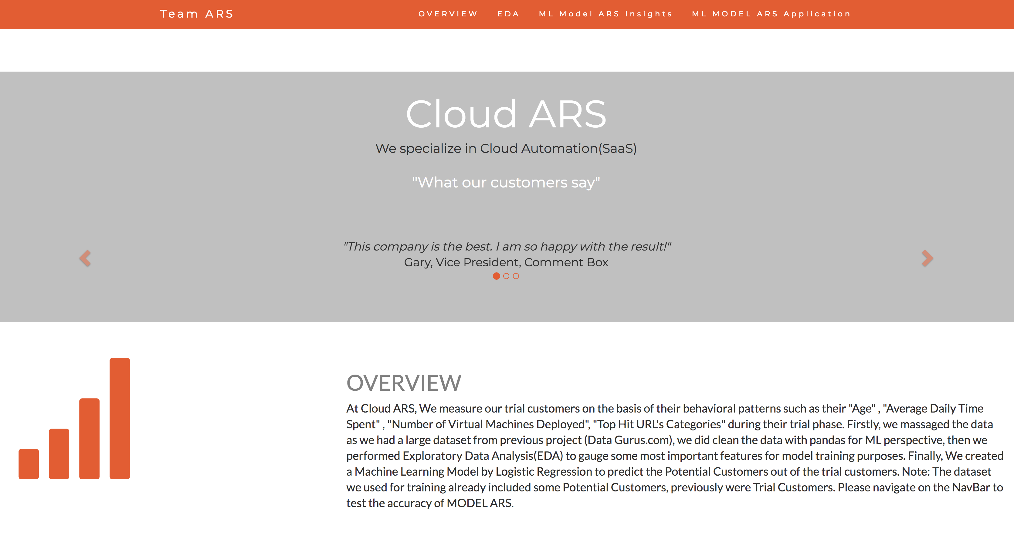
RESPONSIVE
PAGE
Deployed on HEROKU
https://ml-predict.herokuapp.com
Desktop Compatible.
Tablet Compatible.
Mobile Compatible.

Slide 15

THANKS!
Any questions?
You can find me at :
@ berkeley.edu
mail@berkeley.edu

Slide 16
CREDITS
Special thanks to all the people for awesome resources :
Presentation template by Anjali , Raja & Sneha.
Photographs by Google Images

